Slide 1
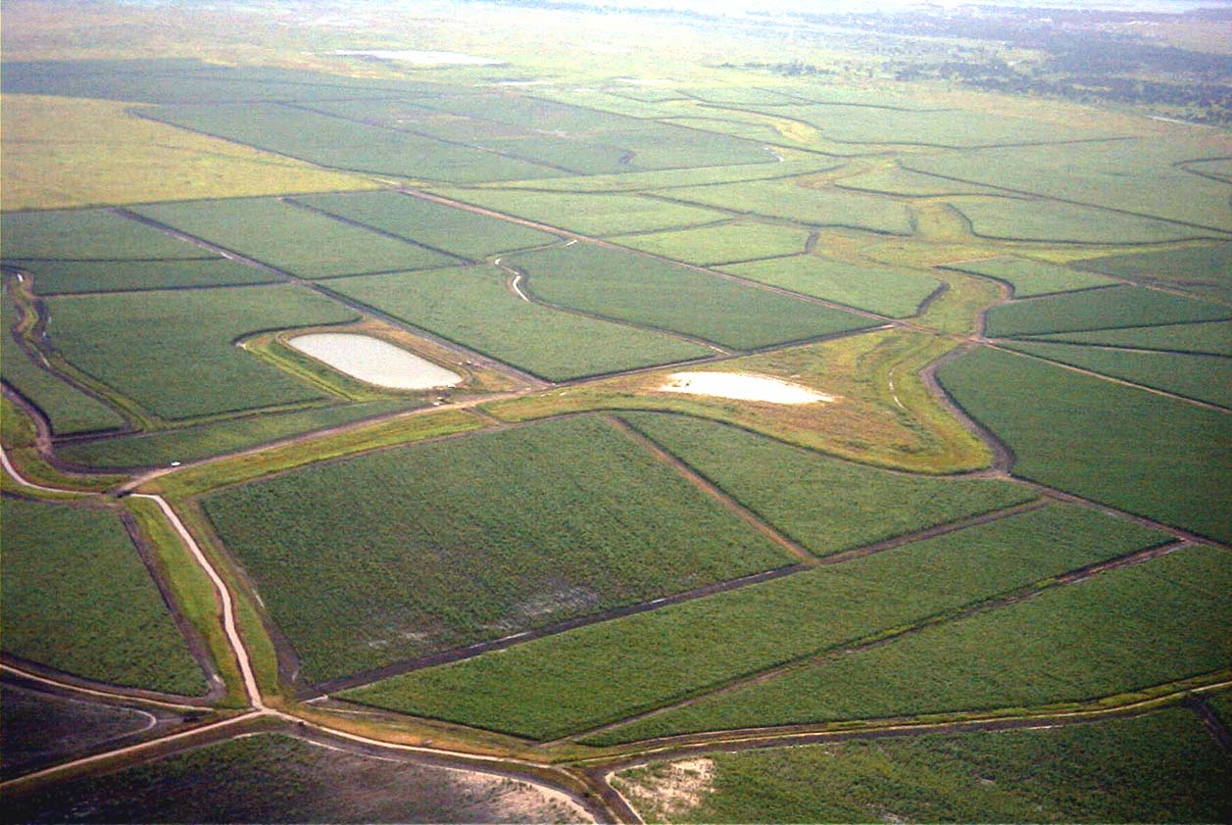

What works and What Lasts
– Sustainable Integration Models at Scale

Slide 2
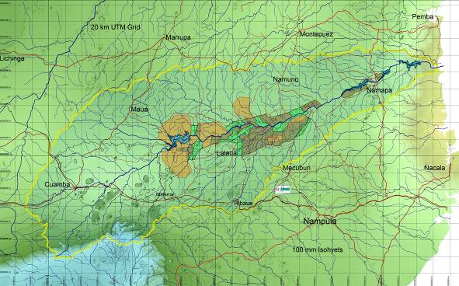
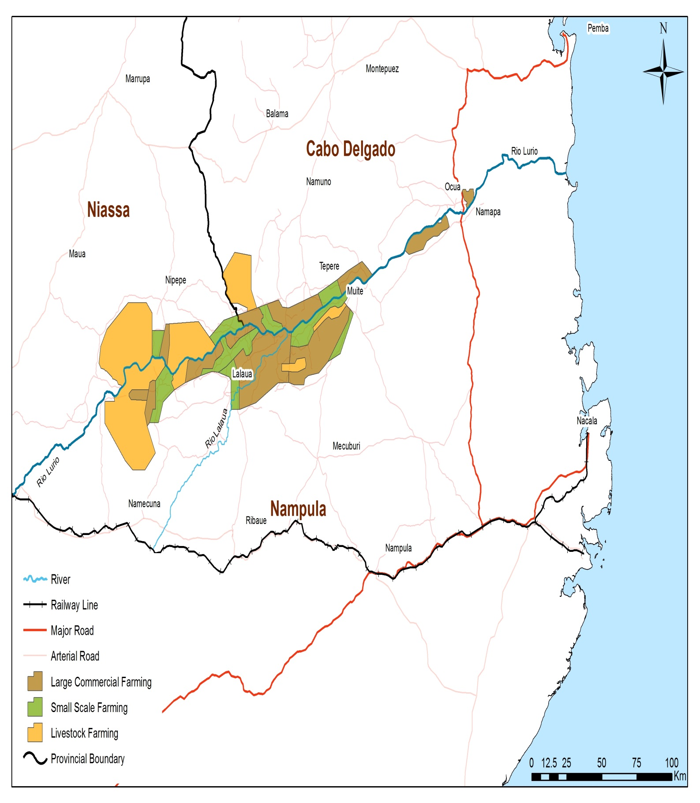
Key Drivers for a sustainable project
Lurio River Catchment Area, Northern Mozambique
At the start -
Identify every catchment resource and quantify and qualify its potential
Great sustainability benefit in integrated private farming and small-grower zones with added value processing hubs.
THIS IS THE ROLE OF GOVERNMENTS

Slide 3
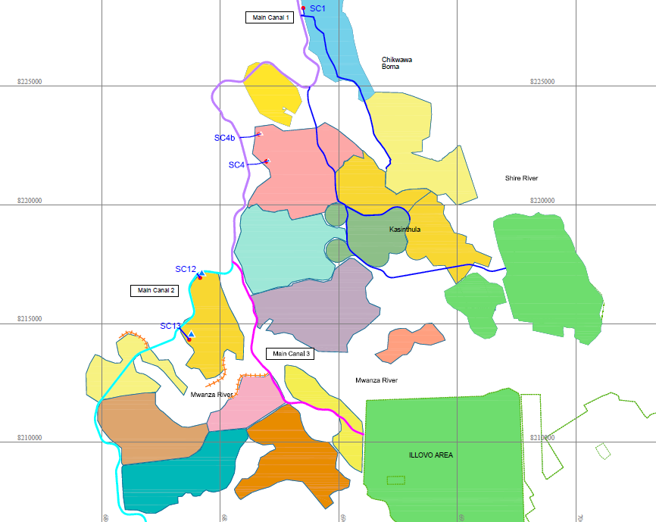



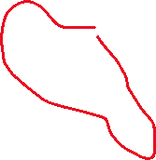
Case Study – Phata Cooperative
MALAWI
Shire Valley, Malawi
Part of the Lower Shire Valley Irrigation schemes which already have :-
  12,000ha estate
  Sugar processing zone
  1,250 ha Private Farmer
  2,000 ha small-growers
New planned irrigation schemes 25,000ha made up of around 50 new cooperatives
Smallgrowers
Private Farm
Large Estate + factories

Slide 4
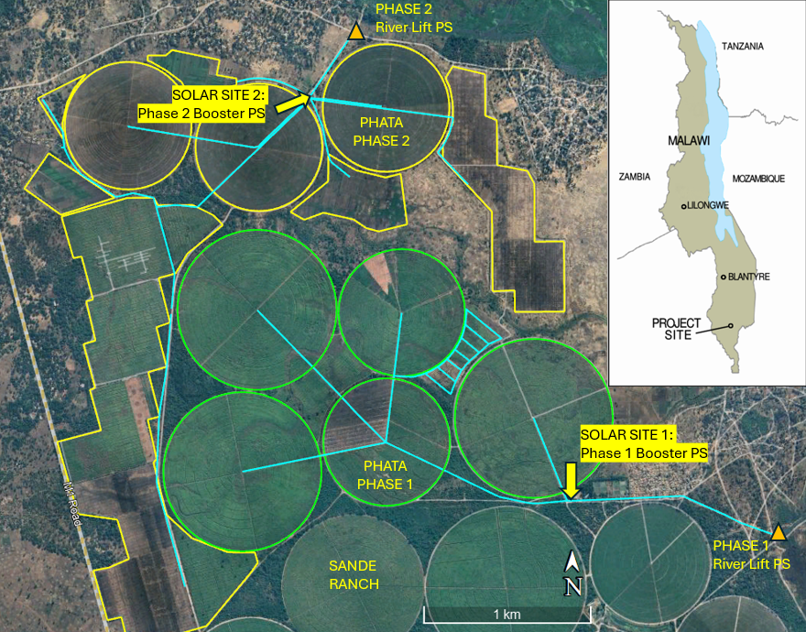
Case Study – Phata Cooperative
MALAWI
600ha Smallgrower Cooperative Going for 15 years – debt free and profitable
1,130 members (ave 0.5ha each)
All donated their land to the project
pro-rata stake based on their original area
Ave income pre-project was <$130/annum and now >$700/annum (plus a job at $800/an)
independent governance structure
Managed as a single commercial entity under 5 year renewable Management agreements

Slide 5
Key Drivers for a sustainable irrigation project?
Integrated Agricultural Development Zone – NOT an isolated scheme.
minimum scale to cover the overheads - > 500ha per scheme
Demand Driven by the members
Good Physical Conditions – Soils, topography, proximity to water & infrastructure.
Financially viable – +70% capital grant/investment and +30% first year Opex
Off-take agreements with reliable and formal market partners
Experienced independent Management contract (at least 10yrs until stable)
Solid governance and institutional set up that is respected by all members.
Careful and appropriate selection of Irrigation Type

Slide 6
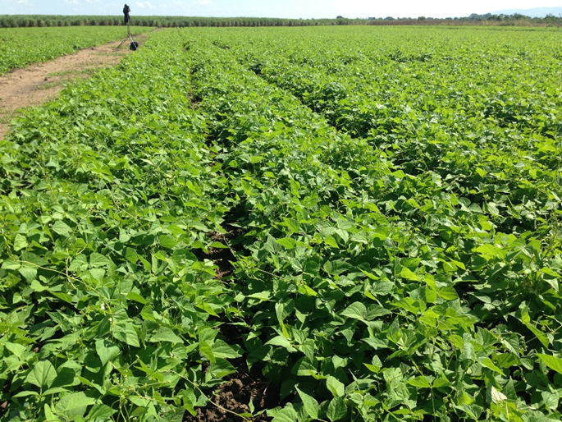
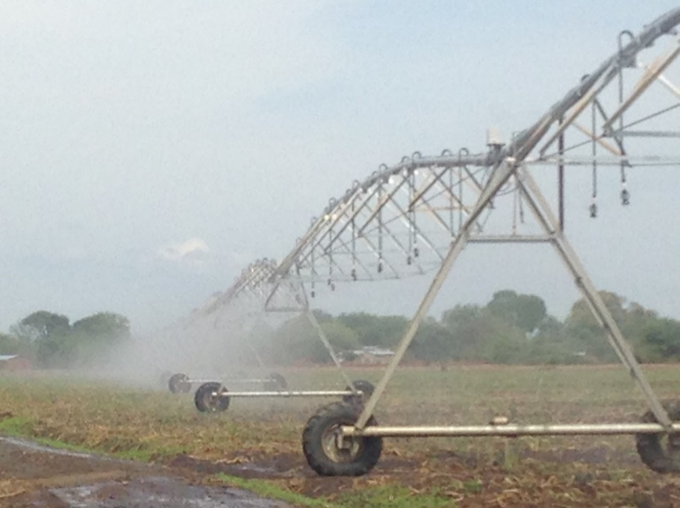
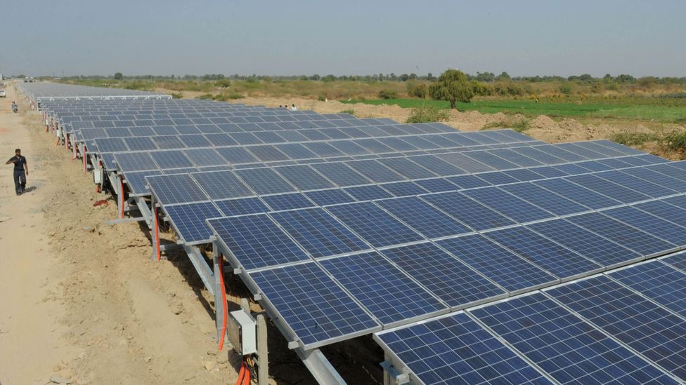
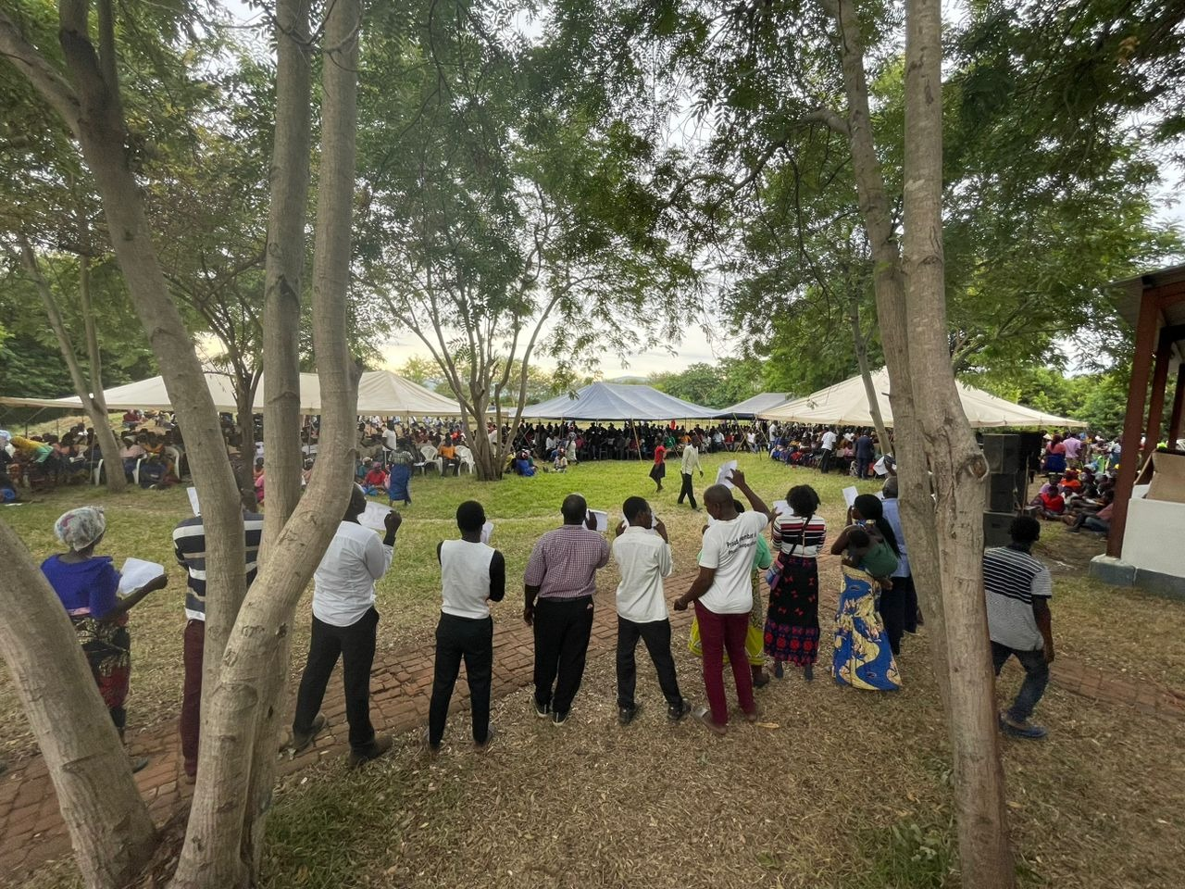
Secondary Drivers for any sustainable project?
Strong alliances with technical partners like Tractor fleet maintenance service providers, and likewise Administrative/Financial partners like banks.
Provision of significant investment in technical and administrative capacity building
Allow for a food security element built into the scheme
Allow for strong environmental considerations including woodlots, soil conservation and IPM
Minimum use of mechanical moving parts that need constant maintenance
Minimum use of Grid electrical power – unreliable and costly
Explore renewable energy sources at the start.

Slide 7
Thank you

