Slide 1


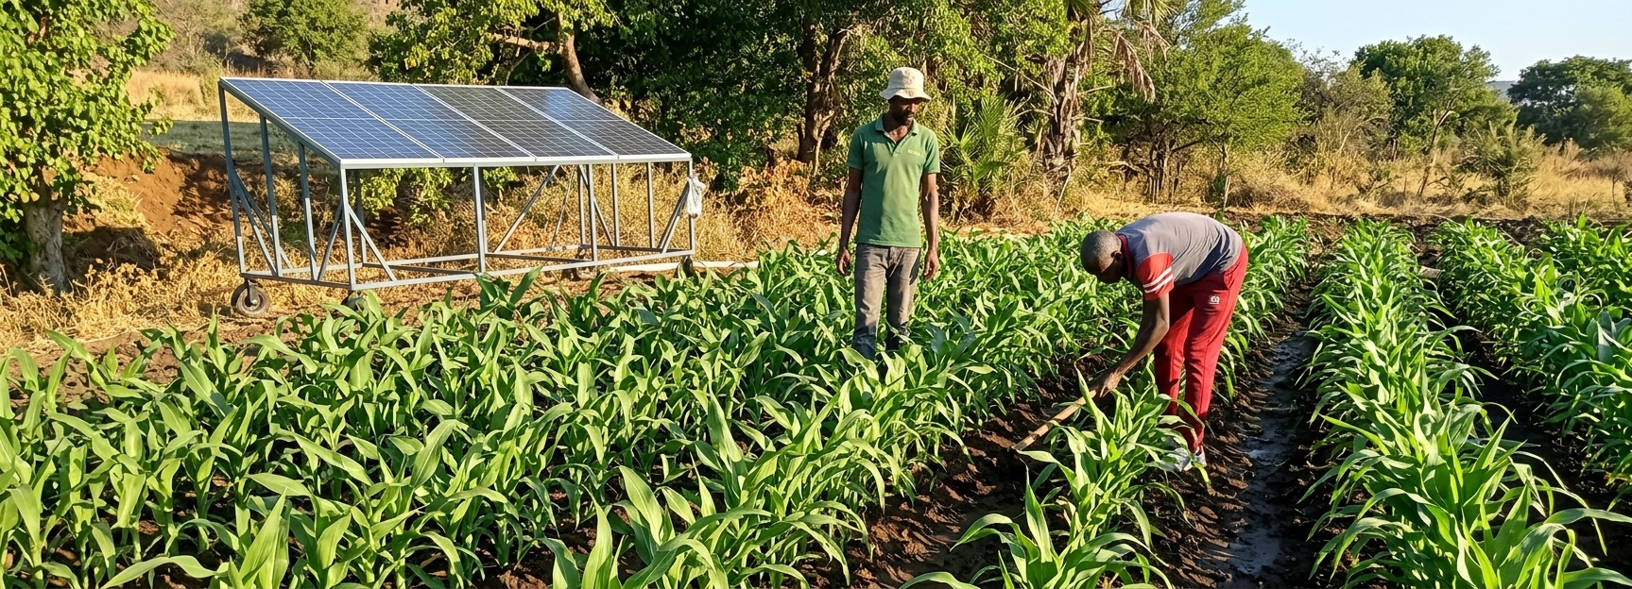
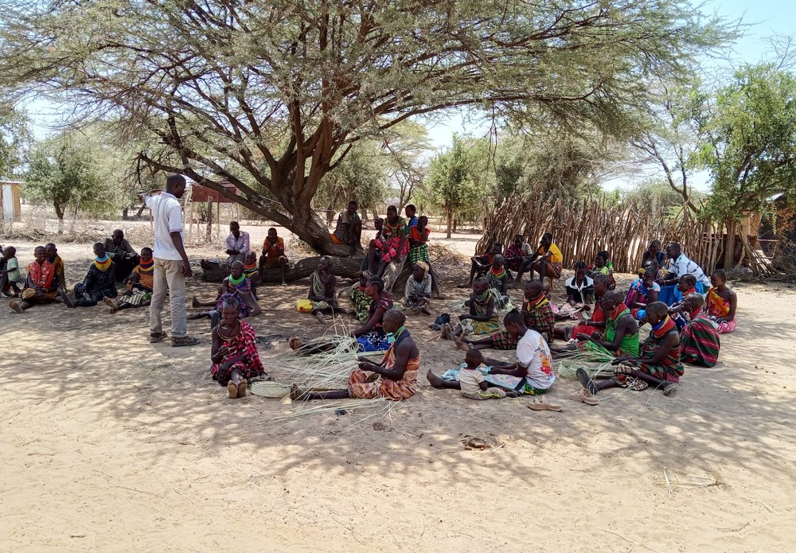
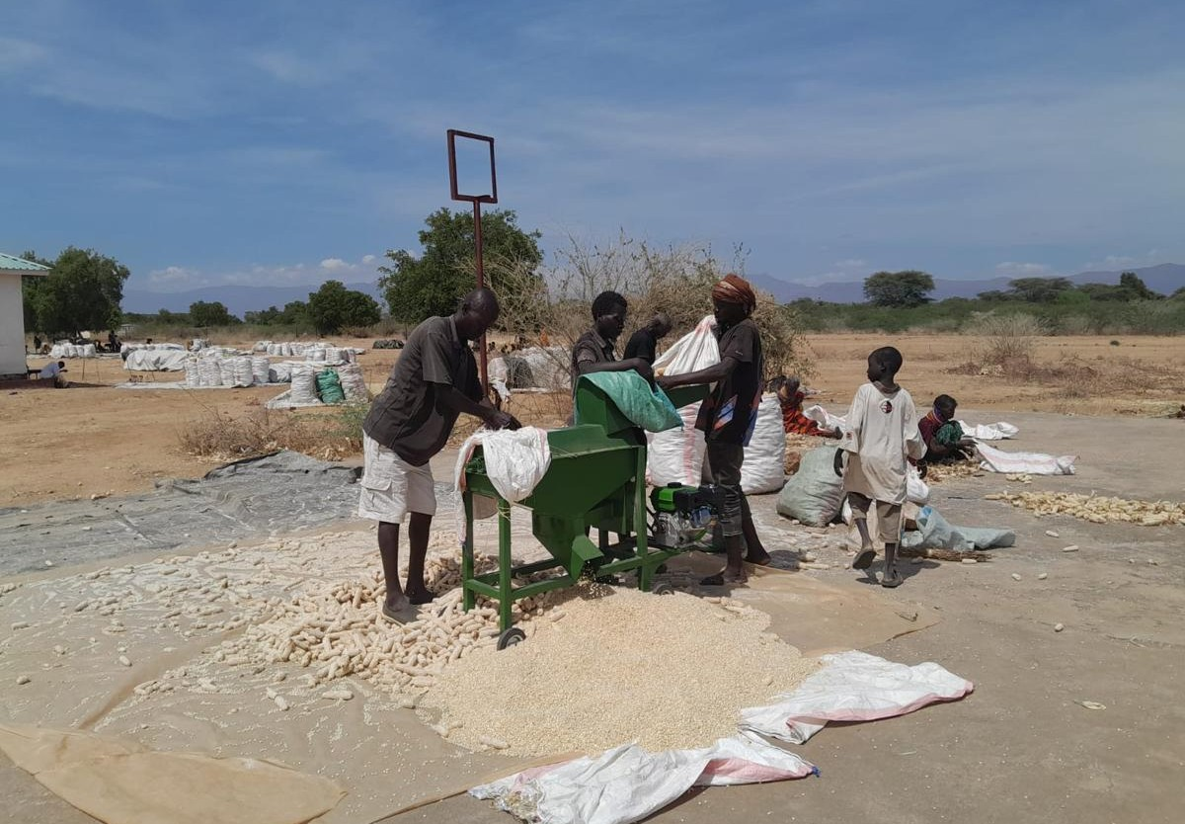
Powering Resilient Agro-Pastoral Livelihoods
CASE STUDY • ENDEV INNOVATION WINDOW
Furrow irrigation on sorghum
A shared solar Energy-as-a-Service model for Kenya’s arid and semi-arid lands.
IMPLEMENTING PARTNER
COUNTIES
PROJECT CODE
ThriveAgric Kenya
Turkana • Isiolo • West Pokot
END5S2509
Community sensitisation meeting
Thresher at work, Turkana
Notes:
[0:00–0:30] Good morning. I am Dr Abraham Ndambuki of ThriveAgric Kenya. In the next seven minutes I will take you through one case study: how we are delivering solar irrigation as a shared, paid service to agro-pastoral farmers in Turkana, Isiolo and West Pokot, with support from the EnDev Innovation Window. I will cover the model, how it operates, the evidence so far, how we protect the water source, and how it replicates.

Slide 2
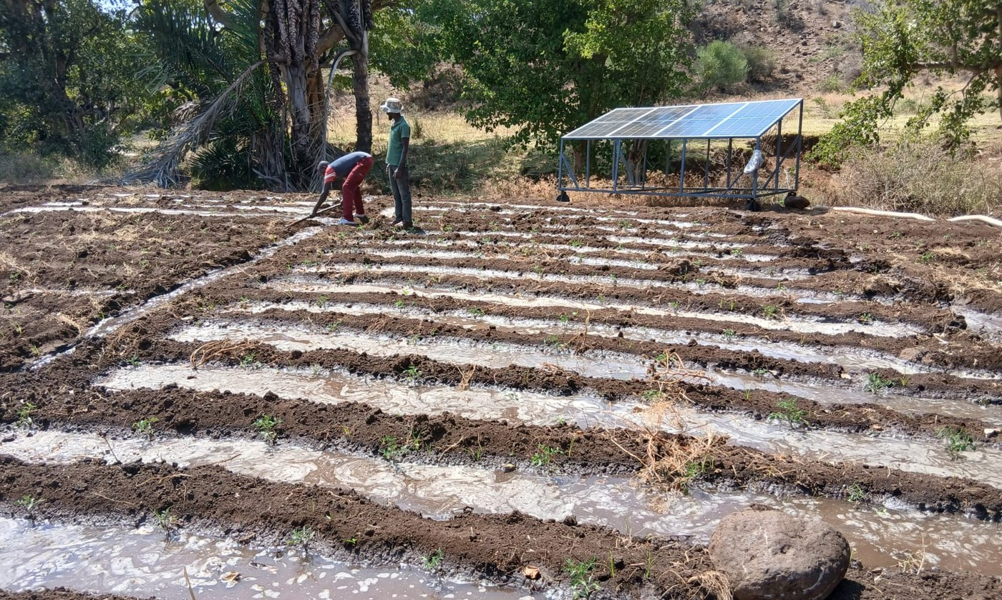




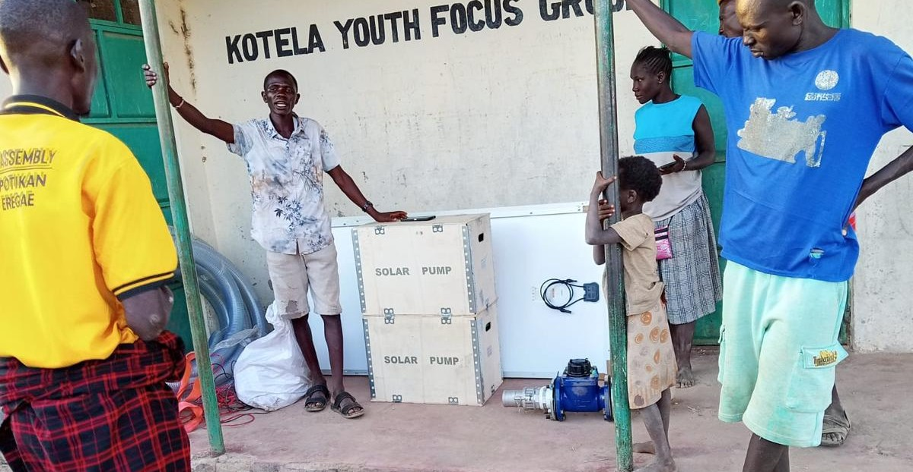
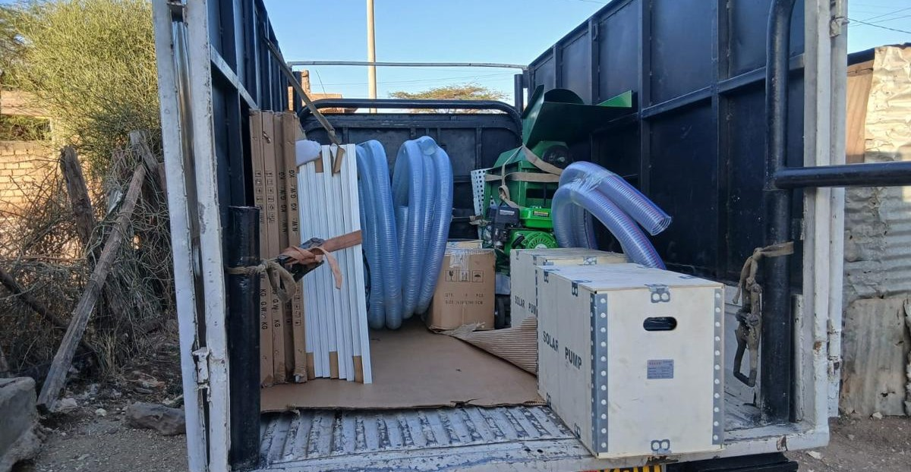
Bundled solar energy, as a service
OUR SOLUTION
Instead of selling one pump to one farmer, we deliver a bundle of solar-powered services through community Farmer Service Hubs. Farmers pay for use, not ownership.
Shared solar infrastructure
Embedded finance + offtake
Mobile solar pumps and threshers shared across farmer groups, with no upfront ownership cost.
Inputs advanced; repayment tied to harvest income and guaranteed offtake.
Digital enablement (AOS)
Agro-pastoral focus
Shared solar pumping at a farmer plot
Farmer profiles, usage and payments tracked on one platform.
Drought-tolerant sorghum and millet for food and livestock feed.
Handover, Kotela youth group
Pump kits delivered to hubs
Notes:
[0:30–1:30] The design choice. In the drylands, a farmer cannot afford to buy a solar pump, and a pump sitting on one farm serves one household. So we do not sell equipment. We sell a service. Four things are bundled. One: shared solar infrastructure, pumps and threshers that move between farmer groups. Two: embedded finance, where inputs are advanced and repaid from the harvest we buy back. Three: our digital platform, the AOS, which profiles every farmer and tracks usage and payment. Four: an agro-pastoral production focus on drought-tolerant sorghum and millet, for both food and livestock feed. The farmer pays for use, not ownership.

Slide 3
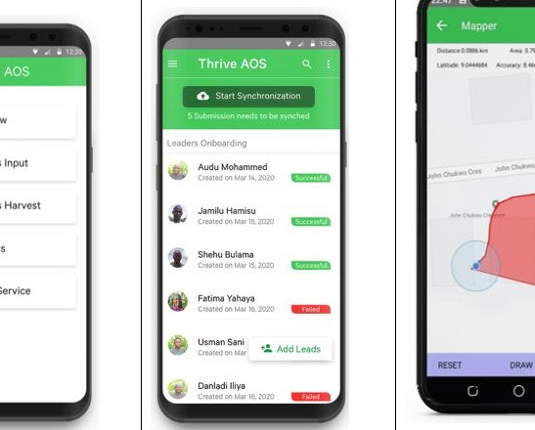
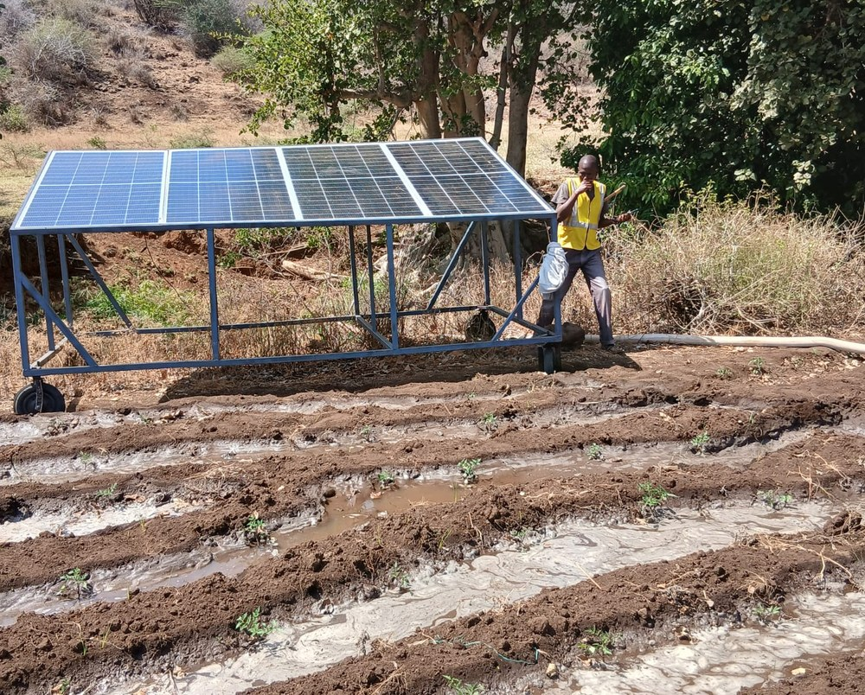
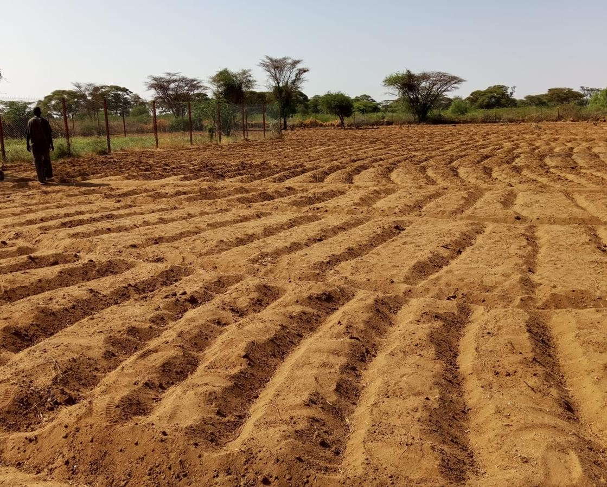
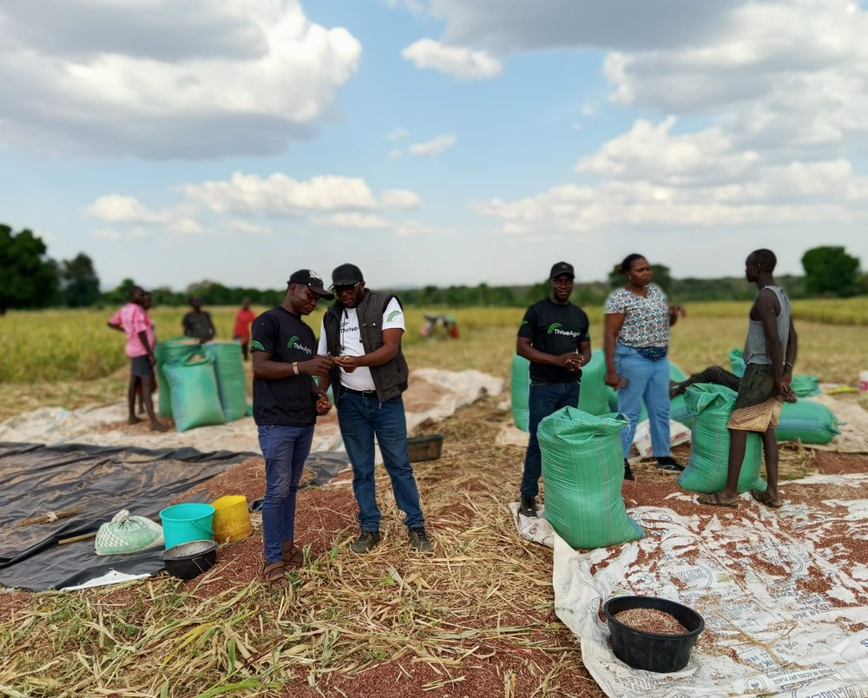
From onboarding to offtake
HOW THE SHARED SERVICE WORKS
Four steps turn one shared asset into a paid service for many farmers.
1
2
3
4
Profile & onboard
Deploy mobile PUE
Pay as you grow
Aggregate & offtake
Farmers are registered and geo-mapped on the AOS, the data foundation for each hub.
A movable solar unit rotates between farmer-group clusters around each hub.
Farmers use solar irrigation and inputs; repayment is tied to harvest income.
Grain is threshed, aggregated and sold through ThriveAgric; usage data feeds credit.
Notes:
[1:30–2:30] The operating model has four steps. Step one: we profile and onboard. Every farmer is registered and their plot geo-mapped on the AOS. Step two: we deploy the mobile unit. It is a solar array and pump on a towable frame, and it rotates between farmer-group clusters around each hub. Step three: pay as you grow. Farmers draw irrigation and inputs during the season, and repay from harvest income. Step four: aggregate and offtake. Grain is threshed on a pay-per-use basis, aggregated at the hub and sold through ThriveAgric. The usage and repayment data then feeds the farmer’s credit profile for the next season.

Slide 4
Live and tested across three ASAL contexts
PROGRAMME SNAPSHOT
Operational results as at mid-September 2026.
3,935
664
14 + 3
180
farmers profiled on AOS
on shared solar pumps
pumps + threshers live
acres under sorghum
131% of the 3,000 target
Flow meters fitted on shared pumps
360 farmers; 162 MT of grain expected in this season
Turkana • Katilu hub
Isiolo • Burat hub
West Pokot • Sigor hub
Canal-fed irrigation scheme
Riverine plots; rationed water source
Weiwei / Lomut riverine belt
1,505 profiled • 90% youth
1,546 profiled • 54% women
884 profiled • 34% women
Notes:
[2:30–3:30] This is not a concept; it is operating. As at mid-September, 3,935 farmers are profiled on the AOS, above our 3,000 target. 264 farmers are actively using the shared solar pumps, up from 202 only four weeks earlier, because uptake follows the crop calendar: land preparation for sorghum drove demand. That is 22 per cent of our 1,200 closure target, so there is still work to do. Fourteen shared pumps and three threshers are in service, and 180 acres are under sorghum for 360 farmers. Importantly, we are testing the model in three different contexts: a canal-fed scheme in Turkana with a 90 per cent youth base, riverine plots with a rationed source in Isiolo where women are the majority, and the Weiwei belt in West Pokot, where women’s participation is our inclusion priority.

Slide 5
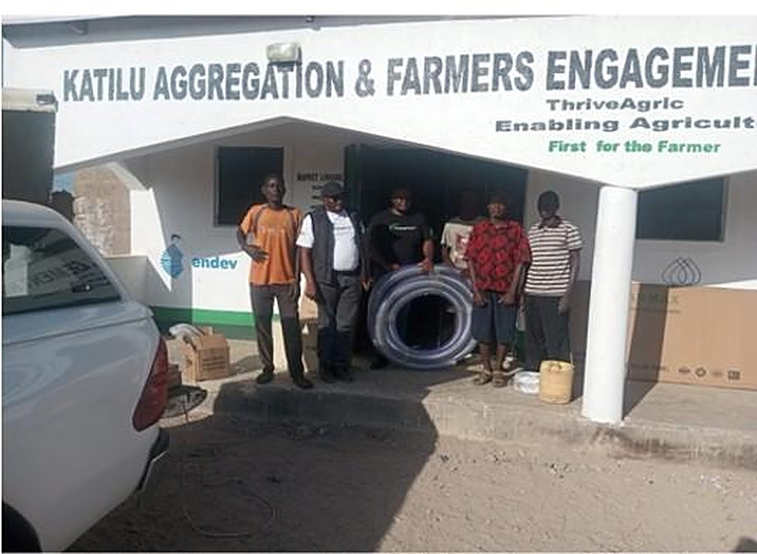
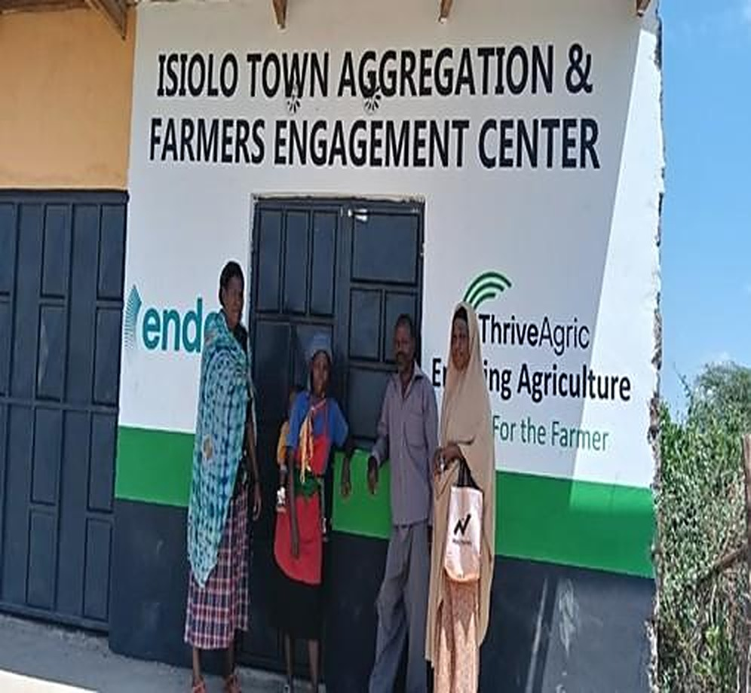
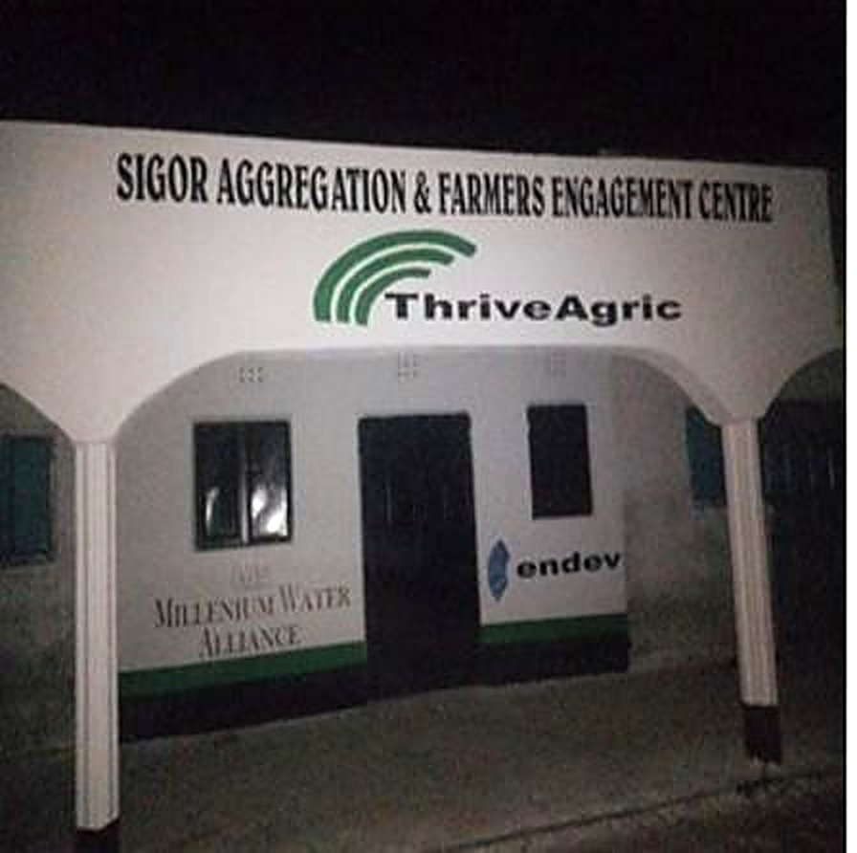
Three branded hubs, live and on-brand
SHARED-SERVICE AGGREGATION CENTRES
Each county is anchored by a branded Aggregation and Farmers Engagement Centre.
Katilu Hub
Isiolo Hub
Sigor Hub
TURKANA COUNTY
ISIOLO COUNTY
WEST POKOT COUNTY
Notes:
Optional slide. These are the three hubs as they stand today: Katilu in Turkana, Isiolo town, and Sigor in West Pokot. Each is a branded Aggregation and Farmers Engagement Centre, and the base from which the shared solar units, threshers and aggregation are run.

Slide 6
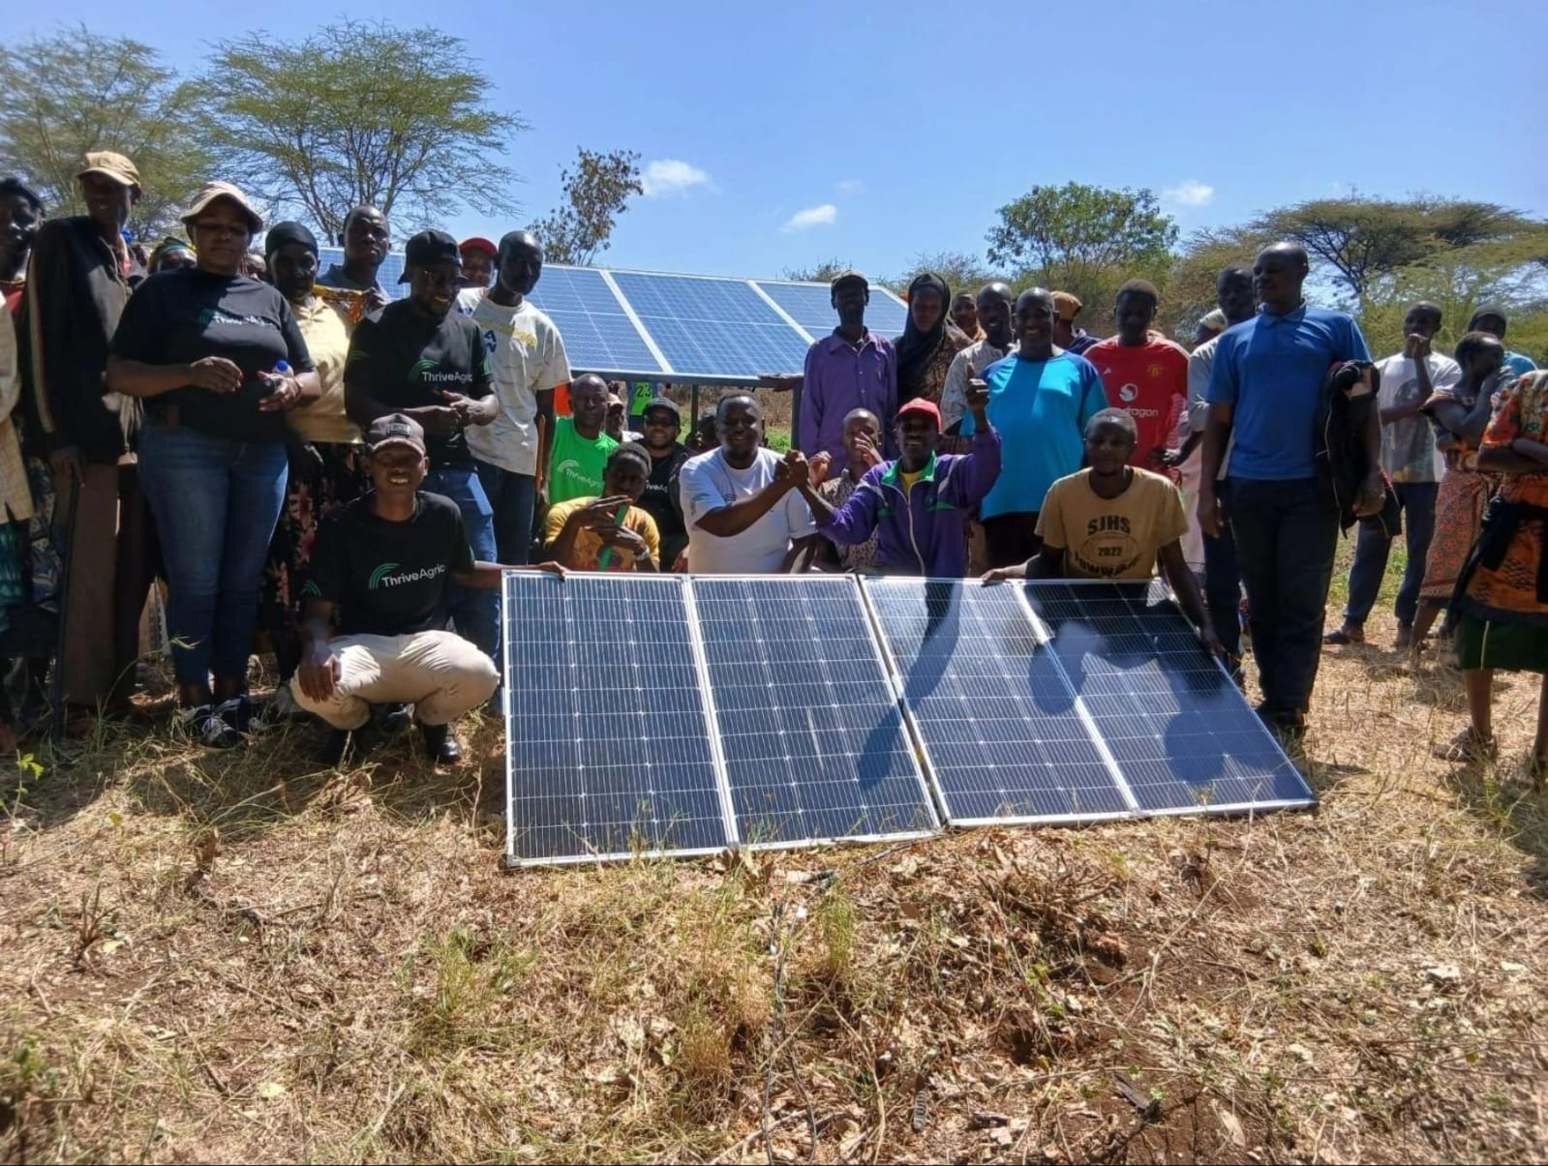
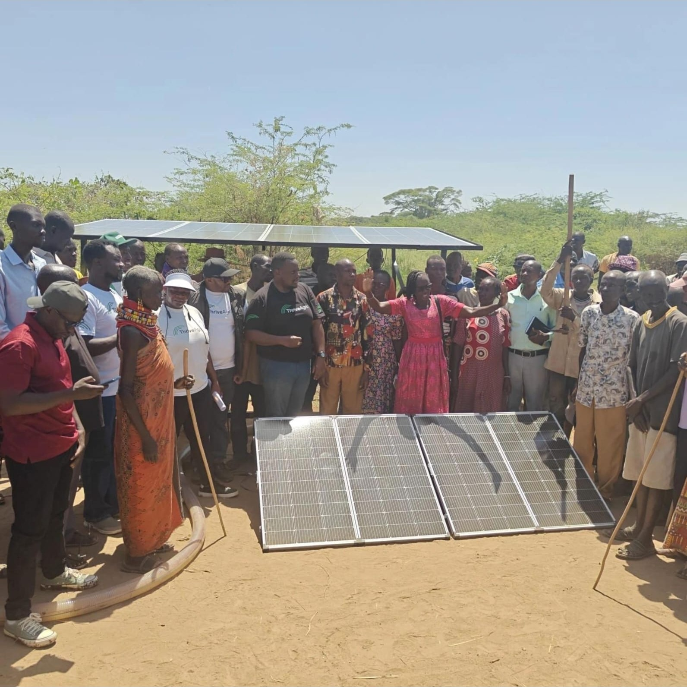
Shared solar units launched with farmer groups
COMMUNITY LAUNCH
Farmers, community leaders and the ThriveAgric team during the launch
Farmers and the ThriveAgric team at a shared solar unit in Isiolo County
Community launch of a shared solar unit in Turkana County
Notes:
Optional slide. The shared solar units were introduced to the farmer groups in the field, with the community and our team present. Use it to show community ownership of the shared asset.

Slide 7
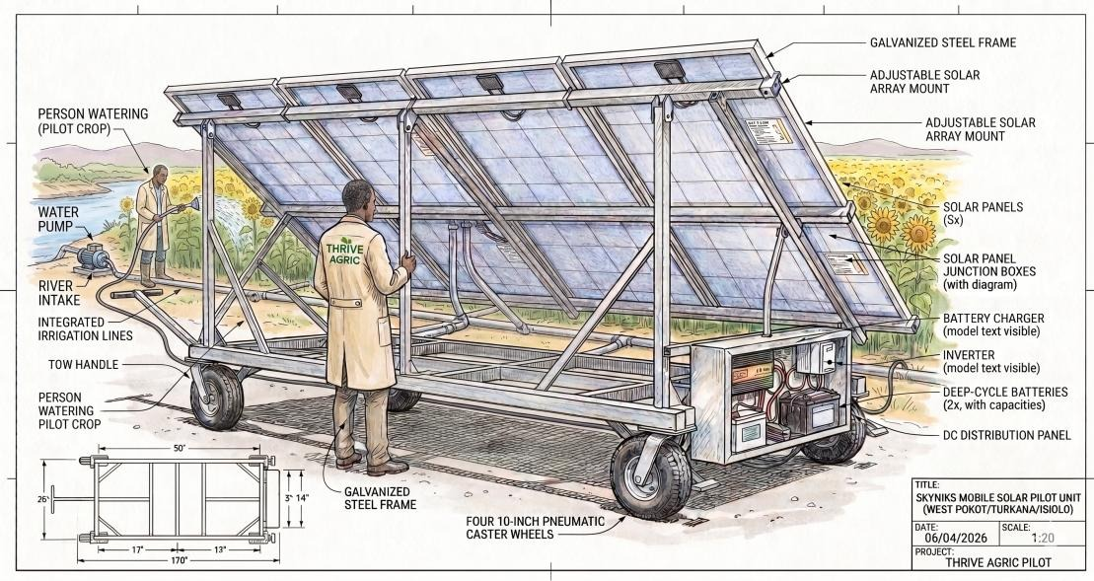
Irrigation-as-a-Service: how it is designed
MODEL DESIGN
Farmers buy irrigation delivered to the field, not the equipment.
1
Asset
Shared solar pump on a towable frame
2
Access
Slots scheduled by cluster rotation on AOS
3
Distribution
Furrow today; drip kits being introduced
4
Payment
Pay-per-use fees, repaid from harvest income
5
Bundling
Agronomy, inputs and guaranteed offtake
The mobile solar pilot unit: adjustable array, pump and controls on a wheeled, towable steel frame.
6
Operations
Hub committees and trained agents run O&M
Notes:
[3:30–4:30] The design in six choices. The asset is a shared solar pump and adjustable array on a towable frame; we had to custom-fabricate it because a shared service cannot sit on one farm. Access: farmers book through their cluster, and the unit rotates on a schedule tracked on the AOS. Distribution: water is applied through furrows today, and we are introducing drip kits to improve efficiency. Payment is pay-per-use, recovered from harvest income rather than cash up front. Bundling: irrigation comes with agronomy, inputs and a guaranteed offtake, so the service earns the income that pays for it. And operations: hub committees and our trained field agents handle day-to-day running and maintenance.

Slide 8
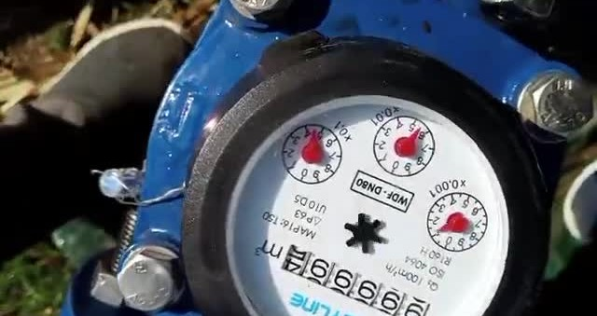
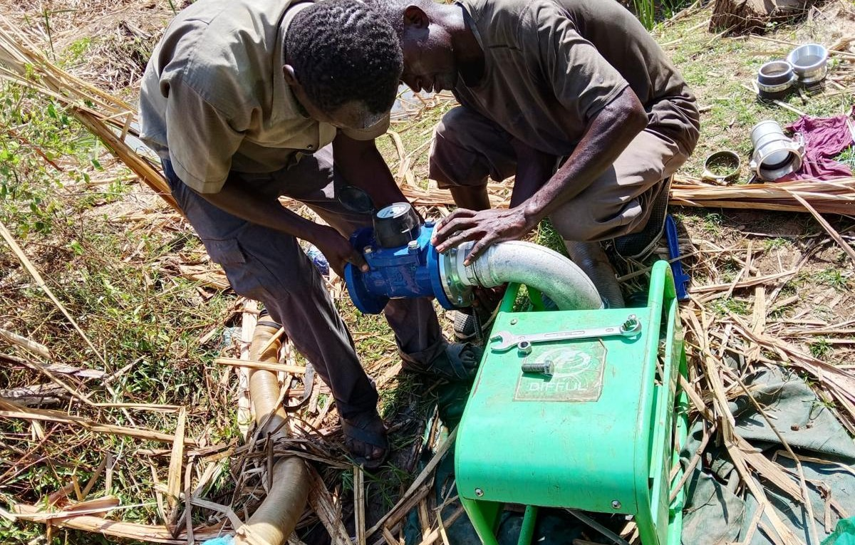
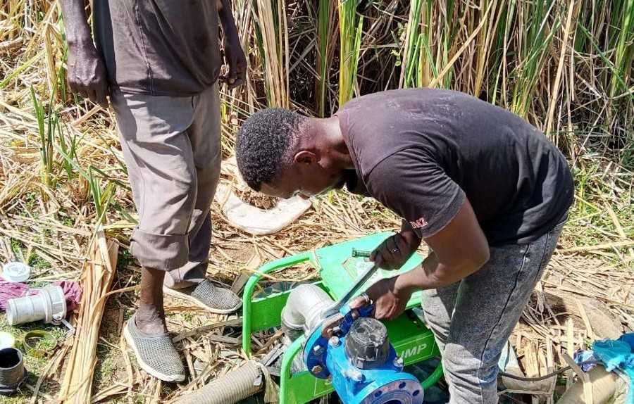
Water stewardship and abstraction safeguards
SAFEGUARDS
Managing over-irrigation and source-depletion risk in fragile dryland water systems.
Metered abstraction
Flow meters on shared pumps log every cubic metre
IN PLACE
Rotating asset
Mobile rig limits continuous draw at any one intake
IN PLACE
Low-water agronomy
Drought-tolerant sorghum and millet cut demand
IN PLACE
Flow meter on the pump discharge
Abstraction governance
WRA permits, WRUA coordination, reserve flows
IN PLACE
Volumetric tariff
Per-m³ pricing to be set from meter readings
NEXT
Storage buffering
Dam liners and harvesting ease river abstraction
NEXT
Fitting the meter
Pump at the intake
Notes:
[4:30–5:30] Solar pumping has near-zero running cost, which is exactly why over-abstraction is a real risk. So stewardship is built into the design. First, we meter: flow meters are fitted on the shared pumps, so abstraction is recorded in cubic metres. Second, the asset rotates, so no single intake is pumped continuously. Third, the agronomy is low-water by design: drought-tolerant sorghum and millet. Fourth, governance: we work within Water Resources Authority permits and with the Water Resource Users Associations. Two items are next. We are not yet charging per cubic metre; we are collecting readings so that the tariff is set on evidence. And we are piloting dam liners and water harvesting to shift reliance from the river to stored runoff.

Slide 9





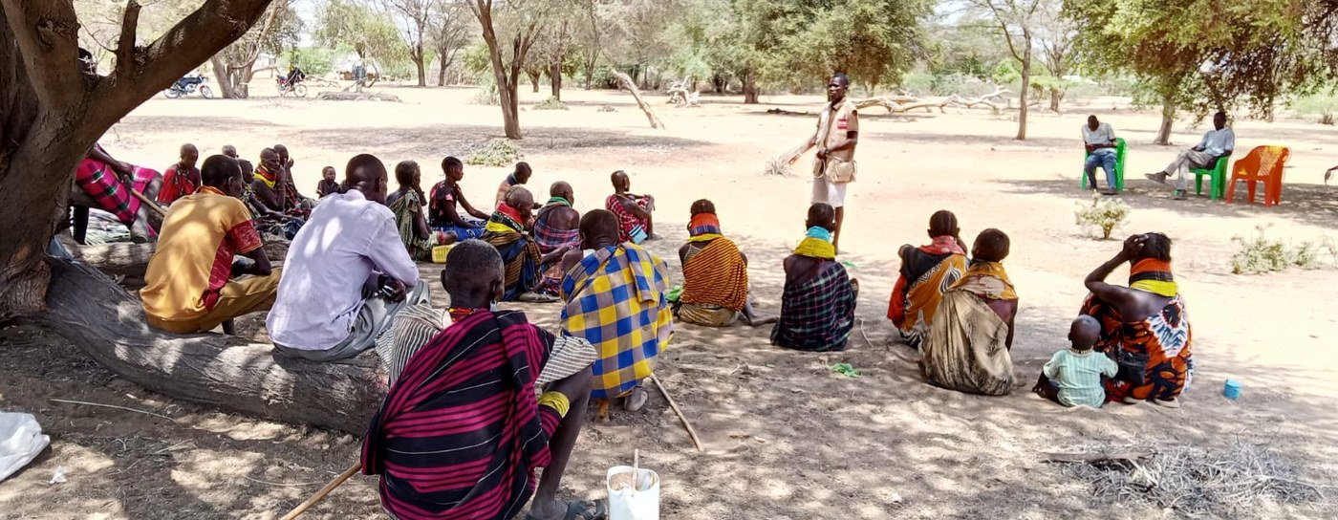
A replication model for new counties
HOW THE MODEL SPREADS
Each proven hub becomes a template: a repeatable playbook that lets the next county start faster and cheaper.
1
2
3
4
5
Proven hub
Codify the playbook
County partnership
Deploy mobile PUE
Scale & learn
A live, branded hub demonstrates the model
Designs, data, pricing and SOPs packaged
County, cooperatives and a local partner
Movable units set up for farmer groups
Usage data makes each cycle cheaper
H1
Deepen
West Pokot • Turkana • Isiolo
H2
Extend
Marsabit • Wajir • Garissa • Samburu
H3
Replicate
Baringo • Tana River • Kitui • Makueni
Community engagement in the field
Notes:
[5:30–6:30] Finally, scale. We treat each working hub as a template. Step one, a live hub proves the model in one county. Step two, we codify it: the unit design, the data, the pricing and the operating procedures become a playbook. Step three, we bring in the county government, cooperatives and a local partner. Step four, mobile units are deployed for local farmer groups. Step five, usage data refines the next rollout, so each cycle is faster and lower-cost. Our horizons: first deepen in West Pokot, Turkana and Isiolo; then extend to adjacent pastoralist counties such as Marsabit, Wajir, Garissa and Samburu; then replicate across the wider dryland belt. [6:30–7:00] To close: shared, metered, pay-per-use solar irrigation can work in fragile dryland settings, provided stewardship and offtake are designed in from the start. Thank you.

Slide 10
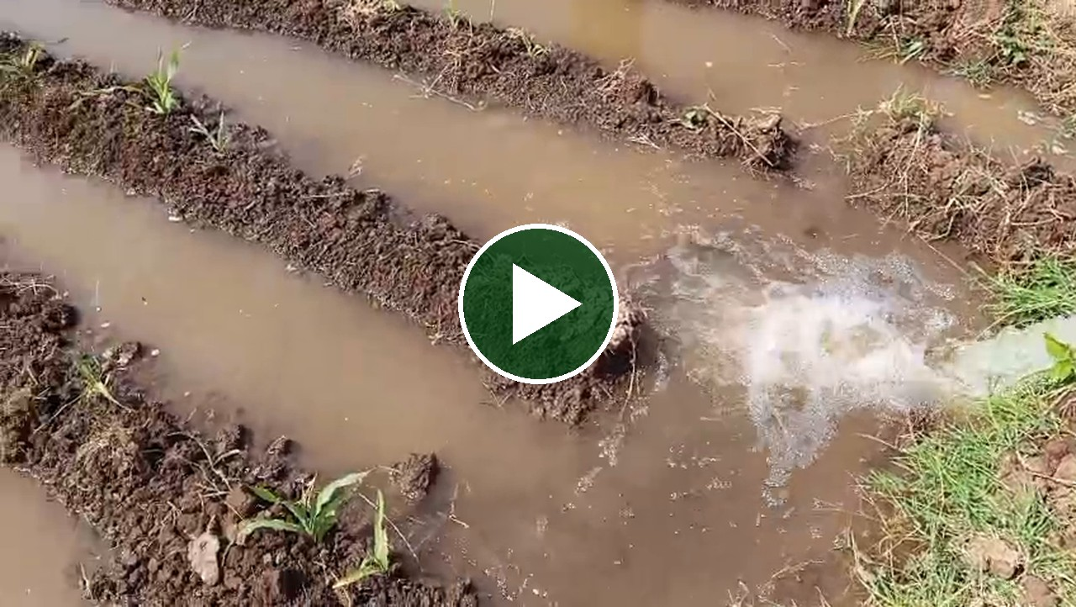
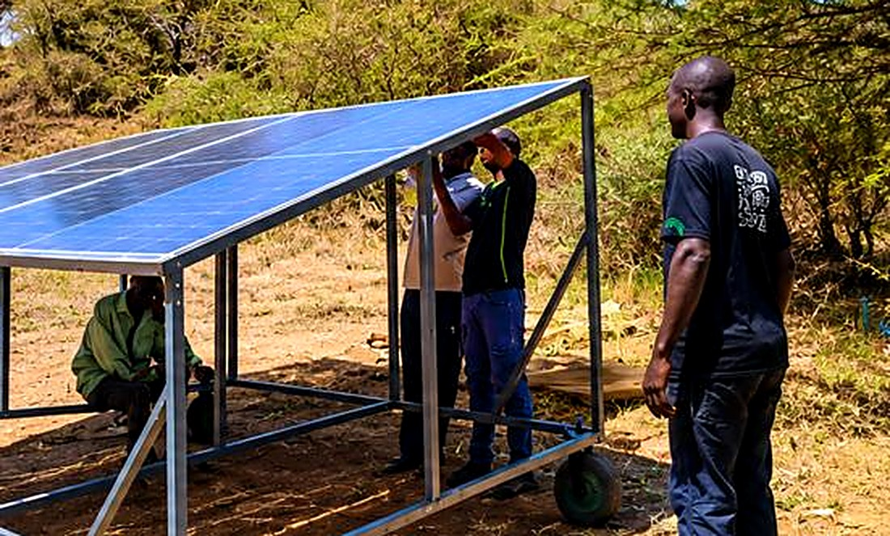
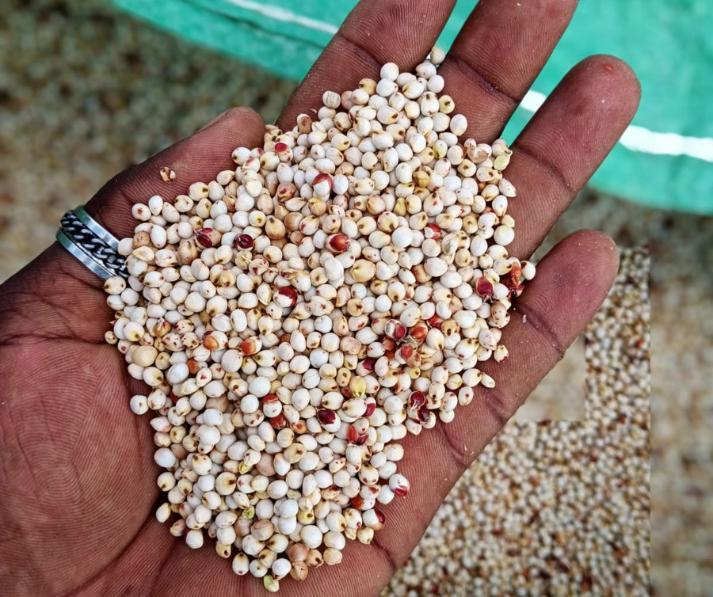
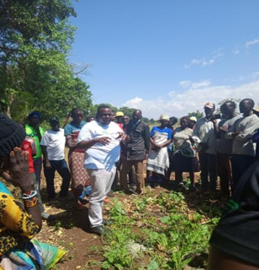
Solar-powered water pumping in action
FROM THE FIELD
The solar unit that powers the pump
Sorghum grain
PUE launch, Isiolo
27-second clip. Plays on click in presentation mode.
Notes:
Optional. The clip runs 27 seconds, so it sits outside the seven-minute script. Play it if time allows or during questions: water from the shared solar pump reaching the furrows.

Slide 11
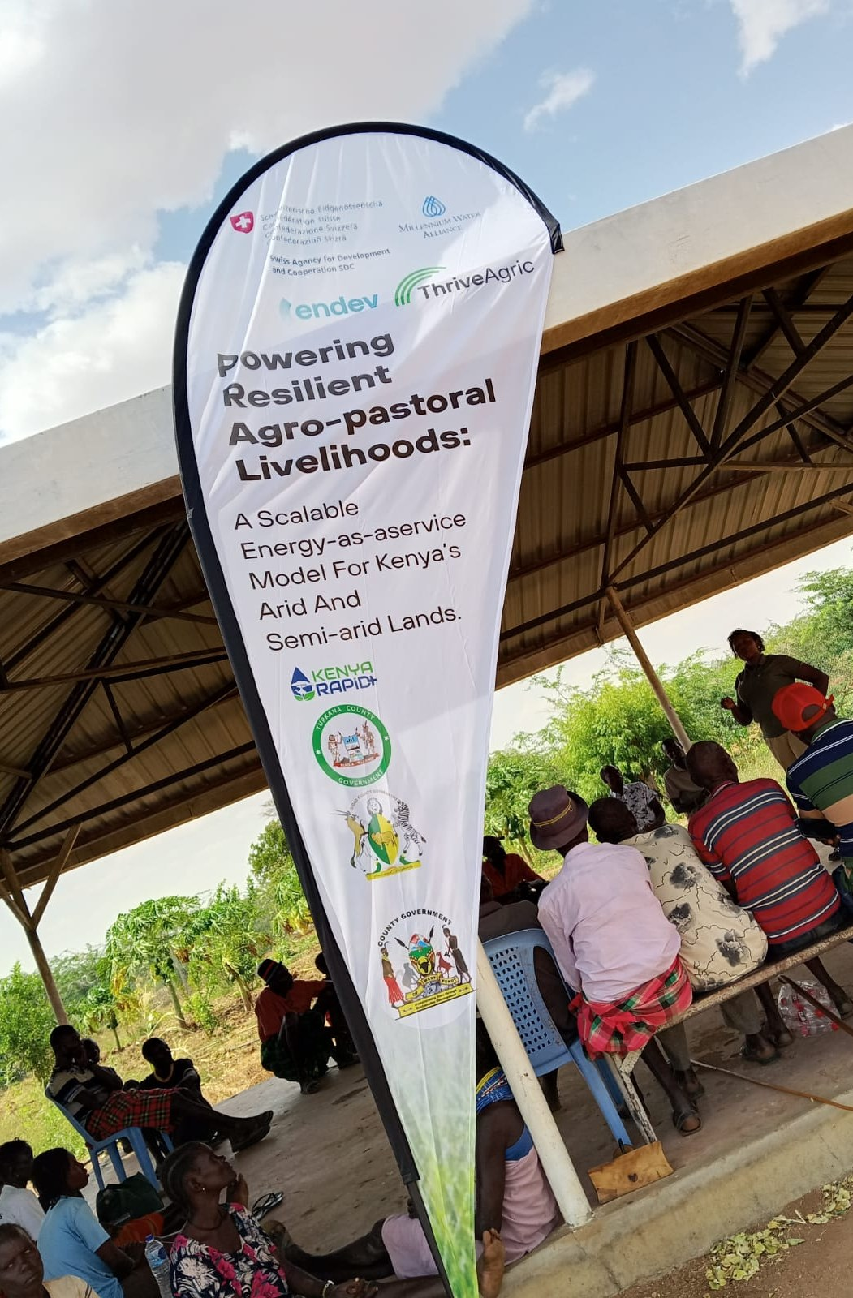
Thank you
Renewable energy, market linkages and resilient ASAL livelihoods.
Dr. Abraham Jeff Ndambuki
ThriveAgric Kenya • EnDev Innovation Window • END5S2509
Notes:
Hold this slide during questions.

