Slide 1


October 2026
DIGITISING VALUE CHAINS AND EMPOWERING FARMERS TO PRODUCE MORE AND BETTER, STREAMLINE VALUE CHAINS FOR SUSTAINABLE PRODUCTION.
ANALYSING ACTION

Slide 2

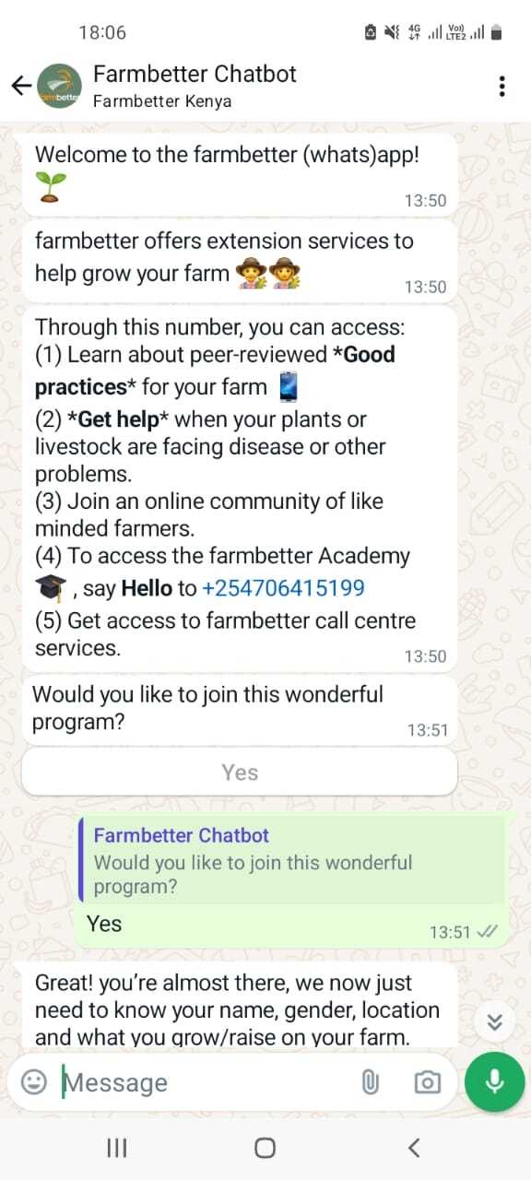



farmbetter 3 in 1
1 - WhatsApp AI Chatbot for Farmers
ACCESS SUSTAINABLE GOOD PRACTICES
TRUSTED RELATION WITH AGENT
JOIN A COMMUNITY OF FARMERS
SHARE AN INNOVATION
REAL TIME GEO BASED ADVISE
CONNECTION TO 3RD PARTY APIs
HIGH QUALITY DATA HARVESTING

Slide 3


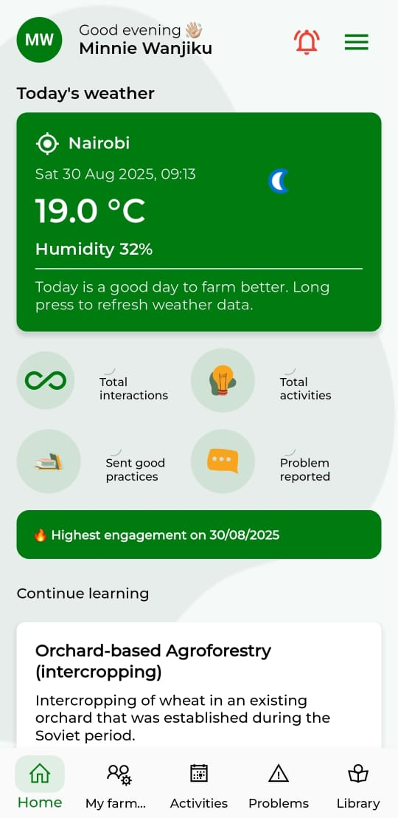

farmbetter 3 in 1
2 - Extension Agent App
Helps farmer advisors increase their efficiency and effectiveness and impact more of their farmer beneficiaries.
Key features include:
Integration with WhatsApp for farmers (no need to download the app)
Group messaging
Share relevant good practices and activities
Manage farmers’ reported problems
Continuous learning from library of good practices
COMING SOON: Earn additional income through commission on marketplace sales
Access to 3rd party API’s
Support for business development as agent

Slide 4

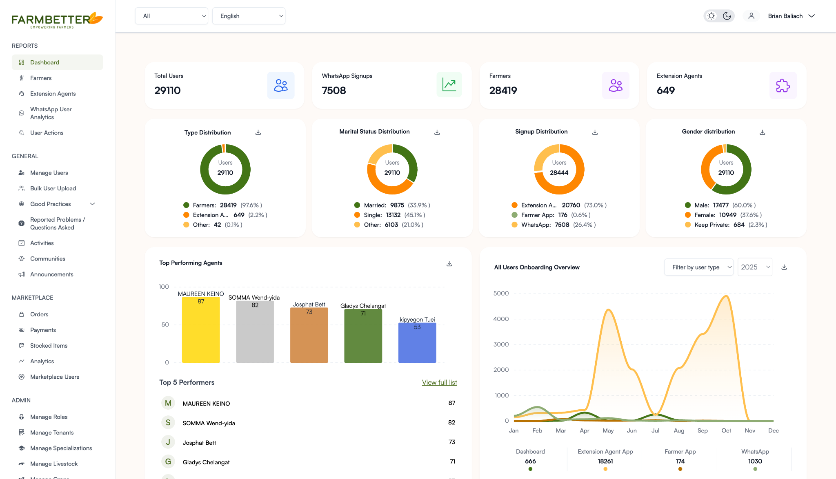
farmbetter 3 in 1
3 - Dashboard for organisational clients
Actionable analytics
A dynamic dashboard to give farmer-facing organizations the ability to improve their advisory services. Real time - 24/7
View registered extension agents and farmers in real time
Gender distribution
Issues reported by farmers
Innovations submitted by farmers
Monitor agents’ activities
Platform for immediate intervention
High quality data collection

Slide 5


Our impact
Proven increased yields and turnover throughout value chains*:growth in yields over 6 months and 17.6% doubled their income.
Economic resilience, sustainable land use, disease & pest management offers positive environmental effects (climate resilience, biodiversity, soil quality).
Currently (Oct 2026) + 70.000 farmers and over 400 extention agents use the farmbetter solutions.
CONNECTION OVER 40 BUSINESSES TO OFFER SERVICES TO FARMERS IN 13 COUNTRIES.
*Based on impact measurement study for users and nonusers conducted as finalists for the 2022 Milken-Motsepe Prize in Agritech

Slide 6
Our approach
CONNECTION VALUE CHAIN PLAYERS
COLLECTING CLEAN DATA
ANALYSIS OF DATA
CONNECTING SERVICE PROVIDERS
INCREASE REVENUE
Partnering with agri businesses NGOs, knowledge centers to create strong and fair value chains. Focus on productivity, climate, youth and women
Integrate services:
- AI-powered chatbot on climate smart solutions, weather, marketplace, credit scoring.
High quality data collection for tailor made advice.
Combining 3rd party solutions under 1 umbrella
Aligned partners to optimise services based on clean data and in person delivery on the ground
Connecting farmers, extension agents and agribusinesses in transparent and easy accessible IT/AI environment

Slide 7

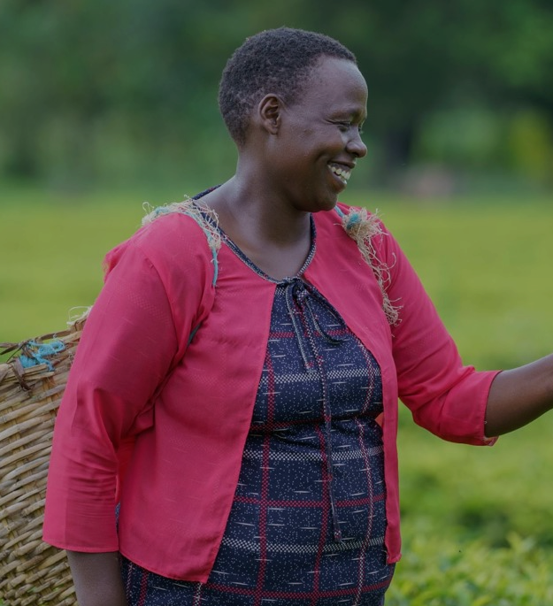



Creating transparency in value chains
Supporting farmers to produce more and better
Supporting sustainable and climate smart farming?
Integrated value chain based approach
Aligning partners to optimise services
Please get in touch:
alexander@farmbetter.io
www.farmbetter.io
www.linkedin.com/company/farmbetter
https://vimeo.com/1128131051/dd49eceab9?fl=pl&fe=sh

