Slide 1
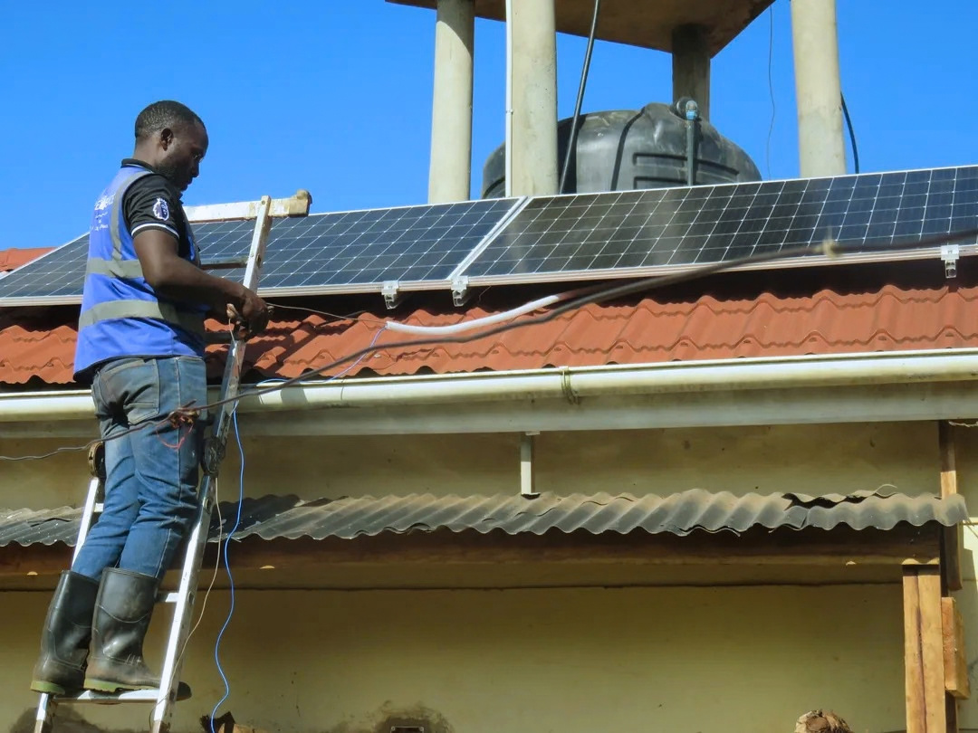

Eastern and Southern Africa Private Sector Forum on Irrigation
What Works & What Lasts in Farmer-Led Irrigation
Why the Pump is Not the Problem - Building Self - Sustaining Permanent Infrastructure
Nairobi, Kenya • October 2026
RESILIENCIA UGANDA LTD
Solar Powered irrigation Solutions
@resilienciaug

Slide 2

SESSION OVERVIEW
Icebreaker & Key Objectives
AUDIENCE POLL
1
Market Realities
Contrast 5 years in Uganda with 2.5 years in SE Asia.
2
The True Cost Breakdown
"Show of hands: How many have seen a portable, small scale solar pumping kit sitting unused in the field?”
Examine why the pump kit is only ~25–30% of total system cost.
3
The Resiliencia Model
Permanent infrastructure with low-cost direct sourcing.
4
Sector Unlocks
Identify takeaways for affordability, credit, and water access.

Slide 3
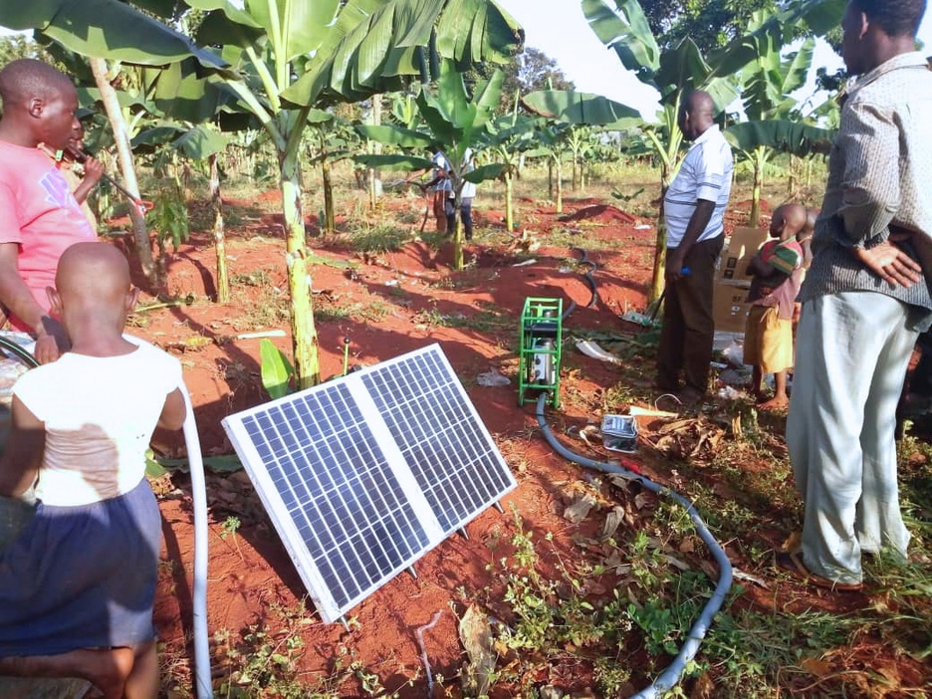
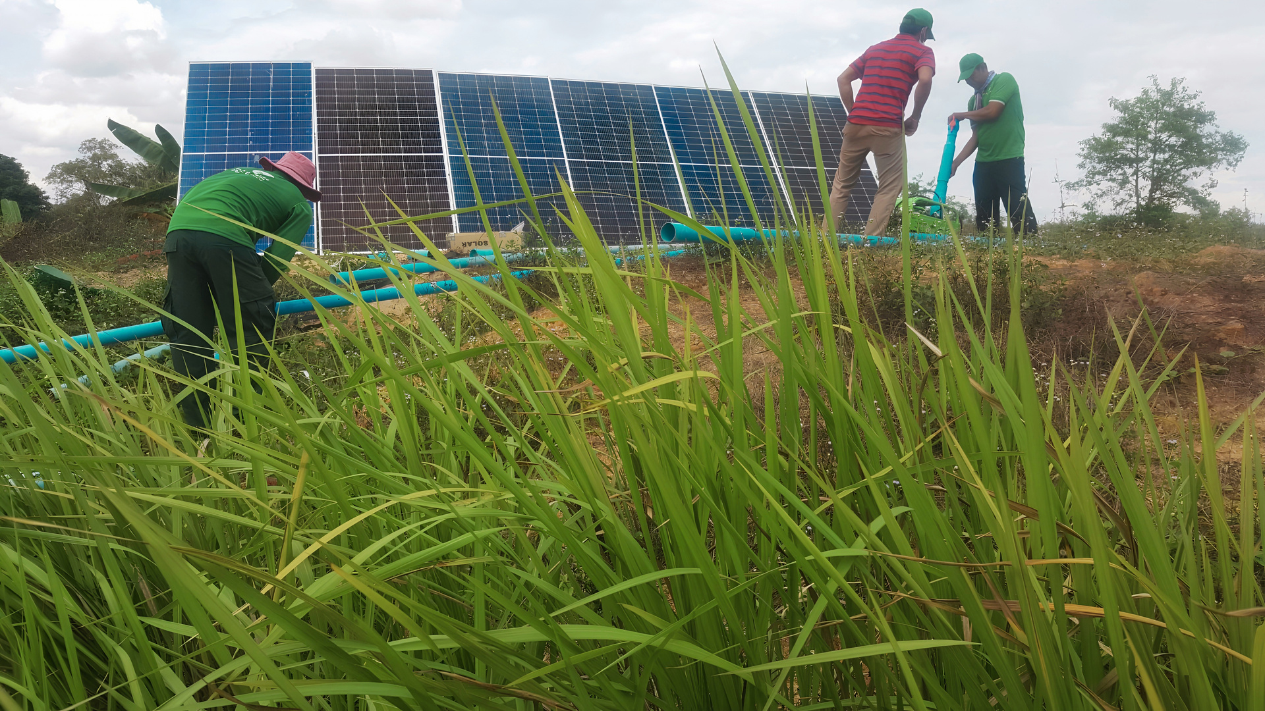
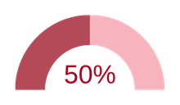

FIELD EXPERIENCE & EVIDENCE
Learnings & Market Realities
UGANDA (5 YRS • SOLARNOW)
SE ASIA (2.5 YRS • AGROSOLAR)
Portable SPIS Kits (~ 800 USD)
Commercial Sized Systems (~1,200 USD)
Distributed lightweight portable kits on credit & subsidy push.
Large-scale permanent SPIS on a cash commercial model.
50% Failure Rate
High Reliability
Within 4 years of mobile operation
Dramatically improved asset care & longevity
Demand: Massive farmer interest in irrigation
Model: Commercial cash transactions
Flaw: Credit repayment risks & mis match with site condition
Proof: Permanent infrastructure drives farmer ownership

Slide 4
SESSION OVERVIEW
FINANCIAL ANALYSIS OF A QUOTE
The Pump is NOT the Problem
Standard System Quote Ratio Breakdown
1. Solar Pump Package - ~10,000 liter / day
2.0M UGX (40% of 5M base)
Core Insight
2. Av. Transport & Installation Service
1.0M UGX (20% of 5M base)
The pump itself is just ~20% of total investment.
Water access, distribution and storage are the real cost items.
3. Water Distribution, Cables & Protection
2.0M UGX (40% of 5M base)
+ Overhead Tank & Tank Stand
+5.0M UGX
+ Shallow Well Digging (Water Source)
+5.0M UGX

Slide 5
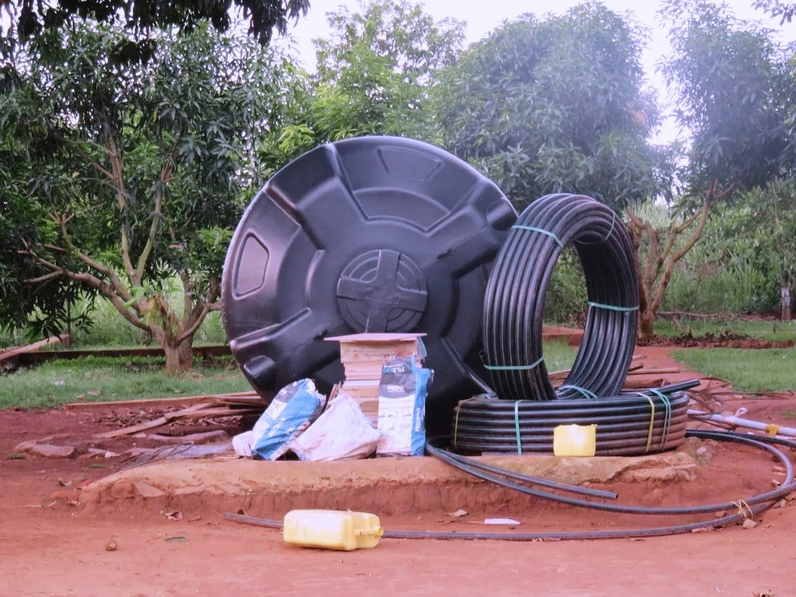
THE RESILIENCIA MODEL
Our Model is Build on Affordability & System Longevity
Customized & Integrated Farm Infrastructure
Infrastructure as the Anchor
Direct Factory Sourcing
Ultra-Lean Sales Operations
Long-term civil and piping infrastructure stays fixed on the farm. The solar pump is treated as an easily replaceable component.
Sourcing pumps directly from Tier-1 manufacturers in China minimizes unit cost, making pump replacement cheap and simple.
Eliminating heavy retail branch networks keeps distribution hyper-efficient and retail prices at rock bottom.

Slide 6
SECTOR RECOMMENDATIONS
What the Sector Needs to Unlock
UNLOCK 01
UNLOCK 02
UNLOCK 01
Commercial Affordability
Access to Water
Permanent Infrastructure
Move away from subsidy-led market distortions. Unlock commercial asset finance and direct sourcing to make hardware genuinely self-sustaining.
Direct public and donor support toward water source development (shallow wells, hydrology testing, drilling) rather than subsidizing pumps.
Assist farmers in co-financing long-term civil works, trenching, and water distribution networks that outlast individual pump units.

Slide 7
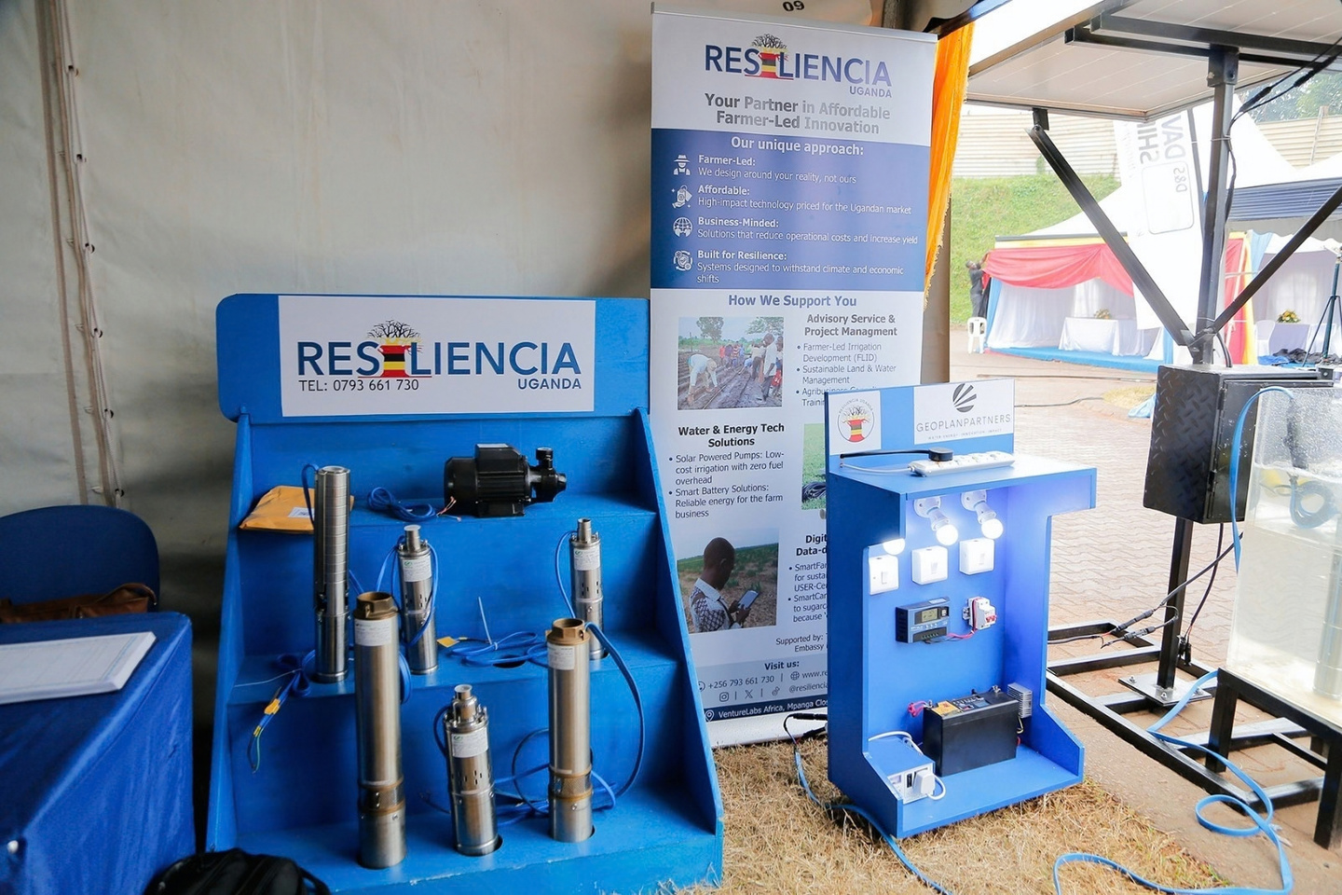
KEY TAKEAWAY
By combining permanent water distribution infrastructure, direct-sourced modular hardware, and lean distribution, SPIS can become affordable and financially self-sustaining.
Remaining Sector Challenge: Access to Water
Thank You
Sandra Bos
+256749629925
sandra@resiliencebv.com
@resilienciaug

